Slide 1
DATS 6203 Final Project Group 6
Convolutional neural network to classify handwritten digits in SVHN dataset

Slide 2
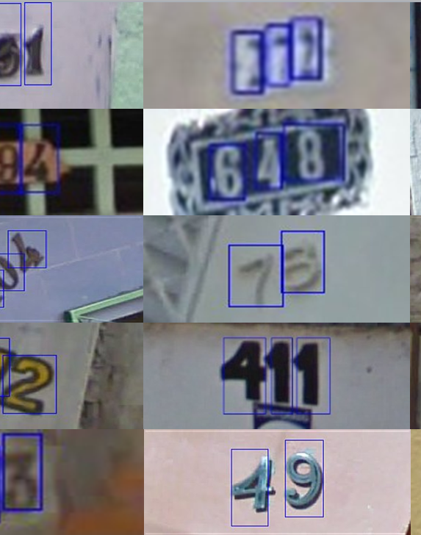
Description of dataset
The Street View House Numbers (SVHN) Dataset consists of images of house numbers in Google Street View images.
Each image is classified as 1 of 10 digits from 0 to 9.
There are 73257 digits for training/validation and 26032 digits for testing.
images that will be used for this project are cropped images of single characters resized to a resolution of 32-by-32 pixels.
The dimension of each images is 32X32X3. 3 represents values of red, green, and blue color channels in a color image.

Slide 3
Pytorch framework
The framework that will be used to implement CNN networks and training algorithms is the torch module in Python utilizing GPU with cuda()
SVHN dataset is available in torchvision module: torchvision.datasets.SVHN
CNN models are defined by specifying layers inside of a sequential container - torch.nn.Sequential()

Slide 4
CNN architecture
Architecture is slightly modified from website:
https://codetolight.wordpress.com/2017/11/30/getting-started-with-pytorch-for-deep-learning-part-3-5-pytorch-sequential/
Model has 2 convolutional layers with 20 and 50 kernels, respectively, each of which is directly followed by a max pooling layer. A 2-d dropout layer and 2 max pooling layers
Flatten is not part of the torch module and has to be defined using .view to reshape the 2-d tensor prior to the fully connected layer
Also need to set model.train() for training and model.eval() for testing. Dropout is only during training.
class Flatten(torch.nn.Module):
def forward(self, input):
return input.view(input.size(0), -1)
model = torch.nn.Sequential(
torch.nn.Conv2d(3,20,5),
torch.nn.MaxPool2d(2, stride=2),
torch.nn.ReLU(),
torch.nn.Conv2d(20,50,5),
torch.nn.MaxPool2d(2, stride=2),
torch.nn.ReLU(),
torch.nn.Dropout2d(0.25),
Flatten(),
torch.nn.Linear(1250, 500),
torch.nn.ReLU(),
torch.nn.Linear(500, 10),
torch.nn.LogSoftmax()
).cuda()

Slide 5
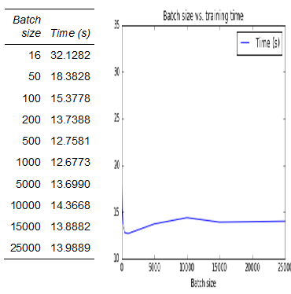
Selecting mini-batch size
The computation times are based on 2 epochs of training using SGD.
Computation time decreases as mini-batch size increases until 1000, and then increases slightly.
Sizes larger than 30000 resulted in a memory error.

Slide 6
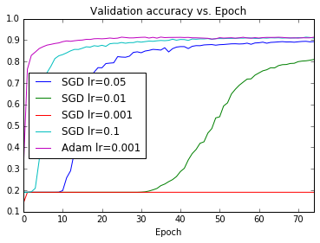
Selecting learning rate and optimizer
Training set of 73,257 images split into 7000 validation and 66257 for training.
Adam with learning rates of 0.1, 0.05, or 0.01 result in no improvement in the validation set accuracy
SGD with learning rate of 0.1 performs better on validation set than 0.01, 0.05, or 0.001
Adam with learning rate of 0.001 performs better after fewer epochs than SGD with learning rate of 0.1

Slide 7
Results
Digit | Precision | Accuracy | F1-score | Support
0 | 0.89 | 0.91 | 0.90 | 1744
1 | 0.92 | 0.94 | 0.93 | 5099
2 | 0.94 | 0.92 | 0.93 | 4149
3 | 0.87 | 0.84 | 0.85 | 2882
4 | 0.88 | 0.93 | 0.90 | 2523
5 | 0.91 | 0.90 | 0.90 | 2384
6 | 0.88 | 0.88 | 0.88 | 1977
7 | 0.92 | 0.89 | 0.91 | 2019
8 | 0.90 | 0.83 | 0.86 | 1660
9 | 0.79 | 0.89 | 0.84 | 1595
Avg/Total | 0.90 | 0.90 | 0.90 | 26032
 | Predicted
Actual | 0 | 1 | 2 | 3 | 4 | 5 | 6 | 7 | 8 | 9
0 | 1590 | 22 | 10 | 19 | 9 | 7 | 38 | 5 | 11 | 33
1 | 43 | 4780 | 47 | 32 | 105 | 11 | 15 | 47 | 7 | 12
2 | 14 | 50 | 3823 | 70 | 58 | 15 | 17 | 53 | 21 | 28
3 | 18 | 95 | 43 | 2407 | 25 | 77 | 20 | 12 | 36 | 149
4 | 16 | 60 | 29 | 19 | 2334 | 6 | 10 | 15 | 11 | 23
5 | 7 | 15 | 19 | 84 | 25 | 2135 | 54 | 4 | 7 | 34
6 | 41 | 16 | 11 | 27 | 33 | 44 | 1747 | 5 | 31 | 22
7 | 5 | 118 | 41 | 31 | 16 | 3 | 5 | 1791 | 2 | 7
8 | 22 | 13 | 10 | 51 | 29 | 27 | 73 | 4 | 1373 | 58
9 | 28 | 18 | 40 | 21 | 19 | 18 | 11 | 3 | 20 | 1417
The CNN model took exactly 5 minutes to train on GPU
Overall accuracy in the test set was 89.88%.

Slide 8
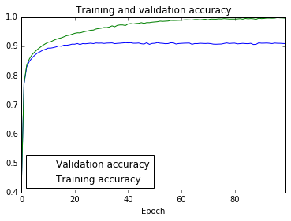
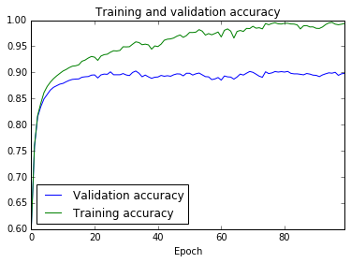
Evaluating the effect of removing the dropout layer
With 2D dropout (89.8% accuracy)
Without 2D dropout: (88.61% accuracy)
Without dropout the accuracy of prediction in both the training and validation sets fluctuates more from one training epoch to the next. The final trained model’s accuracy on the test set is slightly less without dropout (88.61% vs. 89.88%)

Slide 9
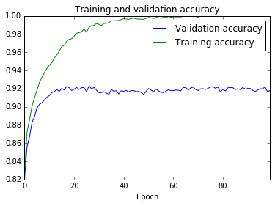
Evaluating the effect of normalizing images
torchvision.transforms.Normalize((0.43768218, 0.44376934, 0.47280428), (0.1980301, 0.2010157, 0.19703591))
Normalizing the images based on the mean and standard deviation in each channel in the training set increased test accuracy from 89.88% to 91.18%.

Slide 10
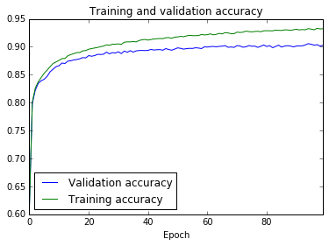
Overfitting
657,080 parameters (91.18% accuracy)
19,590 parameters (89.8% accuracy)
. Reducing the second convolution layer from 50 to 10 kernels and the fully connected layer to 50 neurons results in a model with 19,590 parameters. There is less overfitting but the test accuracy is reduced to 89.8%.

Slide 11
Varying the number of convolutional layers
The table is based on varying numbers of convolutional layers with 20 kernals of size 5 and stride 1 followed by a max pooling layer of size 2 with stride 1.
The number of neurons in the fully connected layer was adjusted so that each model has roughly 1.4 million parameters to train.
Training time increases with number of layers, but accuracy is highest for 3 layers.
# layers | Time (s) | Accuracy
1 | 71.077 | 0.83340
2 | 375.280 | 0.88303
3 | 453.275 | 0.90565
4 | 508.127 | 0.89705
5 | 538.272 | 0.89866

Slide 12
Adding additional convolutional layer to CNN
model = torch.nn.Sequential(
torch.nn.Conv2d(3,20,5),
torch.nn.MaxPool2d(2, stride=2),
torch.nn.ReLU(),
torch.nn.Conv2d(20,50,5),
torch.nn.MaxPool2d(2, stride=1),
torch.nn.ReLU(),
torch.nn.Conv2d(50,50,5),
torch.nn.MaxPool2d(2, stride=1),
torch.nn.ReLU(),
torch.nn.Dropout2d(0.25),
Flatten(),
torch.nn.Linear(800, 700),
torch.nn.ReLU(),
torch.nn.Linear(700, 10),
torch.nn.LogSoftmax()
).cuda()
After adding 3rd convolutional layer with 50 kernals and change stride to 1 and 700 neurons in FC layer, accuracy increased to 91.59%
Approximately 6 minutes to train model with GPU
Images of 1 were classified most accurately (95%) while images of 0 and 8 were classified least accurately at 89%. The cross-tabulation above shows how images of each digit were classified in the test set. Both 0 and 8 were most often misclassified as 6.
 | Predicted
Actual | 0 | 1 | 2 | 3 | 4 | 5 | 6 | 7 | 8 | 9
0 | 1557 | 21 | 17 | 22 | 6 | 7 | 46 | 10 | 17 | 41
1 | 27 | 4823 | 43 | 59 | 38 | 18 | 9 | 46 | 32 | 4
2 | 5 | 30 | 3932 | 72 | 14 | 15 | 13 | 32 | 26 | 10
3 | 9 | 43 | 48 | 2599 | 9 | 54 | 15 | 14 | 39 | 52
4 | 9 | 85 | 29 | 32 | 2293 | 12 | 18 | 13 | 16 | 16
5 | 7 | 13 | 17 | 113 | 14 | 2137 | 48 | 4 | 17 | 14
6 | 20 | 14 | 16 | 29 | 10 | 45 | 1778 | 4 | 49 | 12
7 | 5 | 99 | 50 | 24 | 5 | 2 | 2 | 1820 | 6 | 6
8 | 13 | 13 | 13 | 29 | 12 | 14 | 57 | 4 | 1476 | 29
9 | 23 | 16 | 52 | 17 | 9 | 6 | 11 | 5 | 27 | 1429

Slide 13
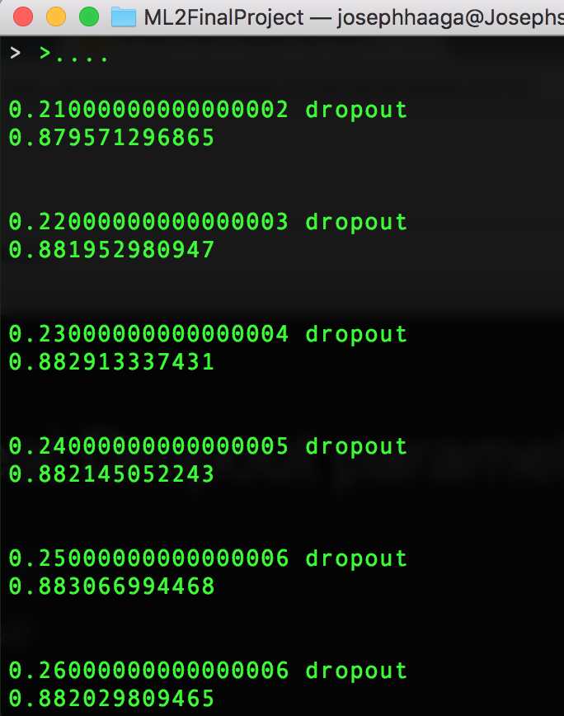
Searching for the best Dropout
Looking for a probability [0, 1]
Iterate thru range of potential values
Hold model constant, while varying just the dropout layer probability
P=0.47 performed the best

Slide 14
Tweaking the network
model = torch.nn.Sequential(
torch.nn.Conv2d(3,20,5,padding=2),
torch.nn.MaxPool2d(2, stride=2),
torch.nn.ReLU(),
torch.nn.Conv2d(20,40,5,padding=2),
torch.nn.MaxPool2d(2, stride=2),
torch.nn.ReLU(),
torch.nn.Conv2d(50,40,5,padding=2),
torch.nn.MaxPool2d(2, stride=2),
torch.nn.ReLU(),
torch.nn.Dropout2d(0.47),
Flatten(),
torch.nn.Linear(640, 320),
torch.nn.ReLU(),
torch.nn.Linear(320, 10),
torch.nn.LogSoftmax()
).cuda()
Add padding=2 to each Conv layer
Change MaxPool stride to 2, preventing redundancies
Update dropout layer with the ideal parameter we found previously
Ultimately resulted in 92.356% accuracy on test set!

Slide 15
Summary
We determined that the optimal way to train a CNN on the SVHN data with Pytorch and GPU is with Adam and a learning rate of 0.001 and a mini-batch size of 1000.
In addition, normalization of images within each color channel improves prediction.
Dropout layer improved performance
The best CNN model has 3 convolution layers and is able to classify 92.36% of the test images correctly.
Additional tweaks that might result in improved performance include additional conv layers, altering the stride, and experimenting with the number of kernels.

Slide 16
Future work
More Conv layers
Different kernel configurations
More epochs
YOLO/SSD?
Capsule networks

Slide 17
References
Diederik P. Kingma, Jimmy Ba Adam: A Method for Stochastic Optimization. 3rd International Conference for Learning Representations, San Diego, 2015
http://ufldl.stanford.edu/housenumbers/
Yuval Netzer, Tao Wang, Adam Coates, Alessandro Bissacco, Bo Wu, Andrew Y. Ng Reading Digits in Natural Images with Unsupervised Feature Learning NIPS Workshop on Deep Learning and Unsupervised Feature Learning 2011.
https://codetolight.wordpress.com/2017/11/30/getting-started-with-pytorch-for-deep-learning-part-3-5-pytorch-sequential/
pytorch.org

